Slide 1



Identification of regional distribution of topics and key influencers using Twitter data on smart cities
Capstone Project Presentation
Kinsuk Ghatak | 15125020 | MBA ,2017
Arpit Jain | 15125009 | MBA ,2017

Slide 2

Company details and problem statement
Problem statement & Deliverables
Sentiment analysis and Topic modelling of Twitter data on movie reviews and smart cities
Pre-processing of the data
Topic modelling of the twitter database on smart cities to
Application of unsupervised algorithm to find out the topics. Finding the geographical distribution of the topics
Making business sense of the topics and labelling of the topics
Identification of key influencers on twitter considering the given data
Development of codes ,algorithms ,visualization and reporting
A leading analytics consulting firm
Works in marketing ,sales, operations ,pharma ,manufacturing and financial domains
Powered by “Mind + Machine”
Notes:
K

Slide 3

Content :
Description about Data
Project Methodology
Data cleaning & Pre Processing
Description of algorithm used
Application of algorithms & Output
Geographic distribution of topics
Identification of key influencers
Business economics and benefits
Conclusion and future scopes
Notes:
K

Slide 4
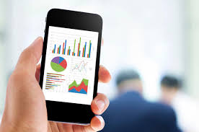
Data Description & Collection :
Movie Reviews data :
Collected from : http://www.cs.cornell.edu/people/pabo/movie-review-data/
2000 tweets : 1000 positive and 1000 negatives
Each tweet as separate .txt file
Initiated for – loop and read all the tweets and stored in a data frame (called df)
Added a separate column to “df” with sentiment ratings as below :
1 for positive Tweet
0 for negative tweet
Topic modelling data as received from the firm :
Notes:
K

Slide 5
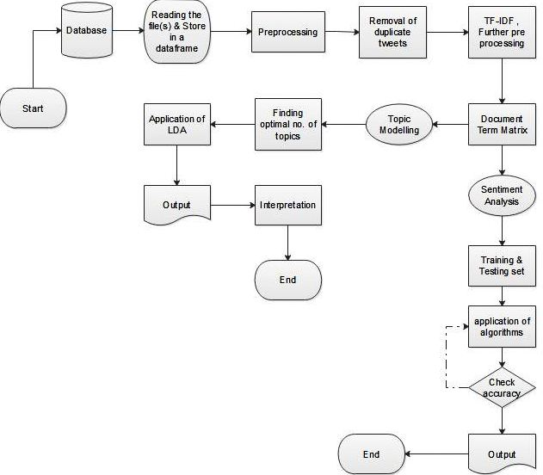

Project Methodology followed :
Notes:
K

Slide 6
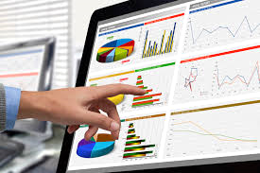
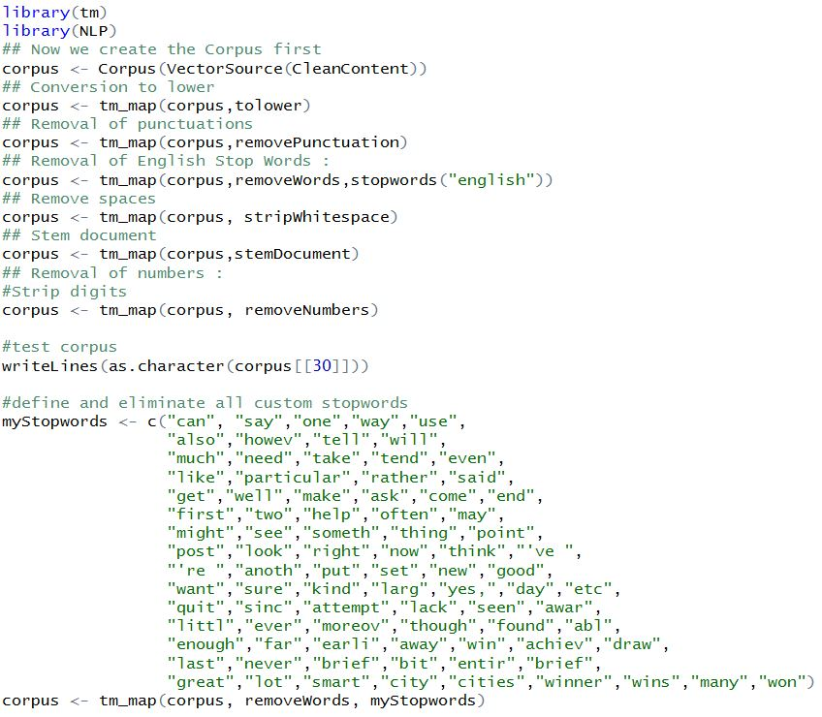
Cleaning & Pre processing :
Package used : tm
User defined function
Removed repetitive tweets but kept re tweets (considering same string from different users)
This reduced the dataset significantly and made the computation faster
Defined and redefined stop words list using our understanding of output and senses.
Notes:
A

Slide 7

Pre processing-2
Cleaning & Pre processing steps
Defined stop words apart from the regular ones
Deleted all the stop words
Prepared corpus
Created Document Term Matrix by omitting words occurring less than 0.5%
Removal of special characters "@, # ,% ,*, $ "etc.
Conversion of the text to lower case
Removal of puncutations
Removal of English Stopwords
Removal of numbers
Stem document
Create Corpus
Define & eliminate custom stop words
Removal of duplicate tweets
Removal of sparse terms
Calculate TF-IDF of words and set a cut off
Remove words with TF-IDF below the cutoffs
Create Document Terem Matrix (DTM)
Remove documents with no terms in DTM
Observe result
End
Start
Notes:
A

Slide 8

Pre Processing : Before & After
Before :
After :
> df <- read.csv("SmartCities.csv")
> df$contents[1]
[1] "#Cbus will soon burst w. electric vehicles autonomous shuttles platooning trucks bus rapid transit & smart traffic lights." ~@WIRED
> writeLines(as.character(corpus[[1]]))
will soon burst w electric vehicles autonomous shuttles platooning trucks bus rapid transit smart traffic light
Notes:
A

Slide 9

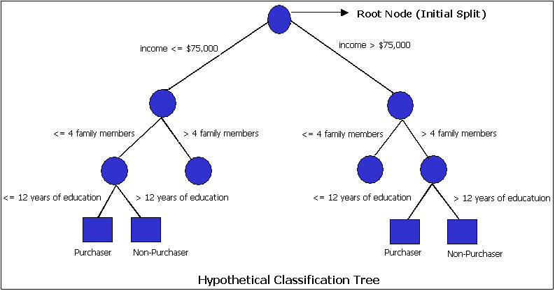
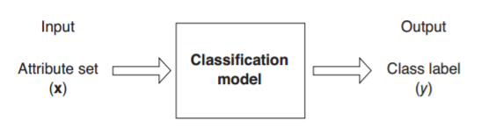
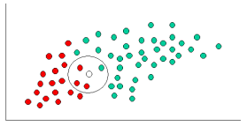
Description of algorithms used in Sentiment Analysis
Classification Tree :
Random Forest
Naïve Bayes
Undirected graph, which is essentially used for classification
Supervised learning algorithm
The tree is created using a method called binary recursive partitioning process
Ensembling method which comprises of many tree
combines the outputs from each and every tree and gives the final result
Divide , rule & predict better
P(A_{i}/B) = (P(B/A_{i})*P(A_{i}))/P(B)
A_{i}: Mutually Exclusive events
B: unique set of attribute
B is B₁ П B₂ П …….. B_{m} j=[1,m] ; m= no. of unique words in a document ; B_{m} = frequency of m^{th} word in a document
Any two attributes in the input set are independent of each other
Concept of posterior and current probability
Notes:
A + K

Slide 10
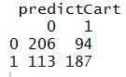
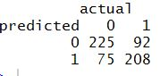
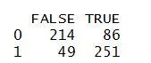
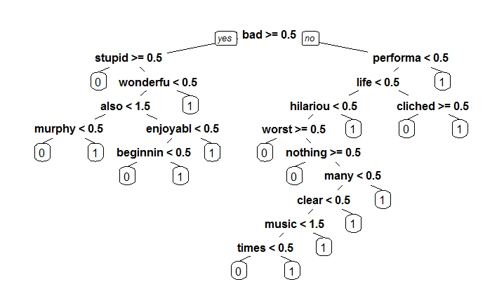

Output of sentiment analysis of the movie database :
Classification Tree :
Naïve Bayes
Random Forest
Used CART, rpart & rpart.plot packages in R
Accuracy of prediction : 62%
Package : e1071
Accuracy came : 72.2 %
Package : randomForest
Accuracy : 77.5 %
If probability predicted > 0.5 then the same is tagged as a true positive.
Notes:
A + K

Slide 11

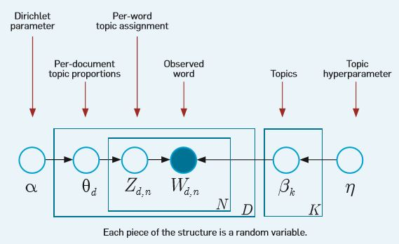
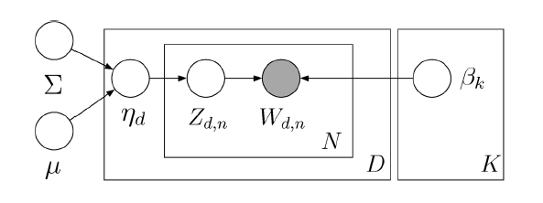
Algorithms used for Topic Modelling :
LDA (Latent Dirichlet Allocation)
CTM (Correlated Topic Models)
α,β : controlling factors controlling per document topic distribution and per topic word distribution
θ : Weight of topics (Distribution of documents over topics)
Topic : as list of words with assigned probabilities of belonging
Documents contain multiple topics
Each topic is a proportion of words
Each document is proportion of topics
Correlation among topics considered
Bag of Words model
Each documents assigned to a topic with maximum weightage
Source: Anthes, 2010
Source: Blei & Lafferty, A Correlated Topic Model of Science, 2007
Notes:
K + A

Slide 12

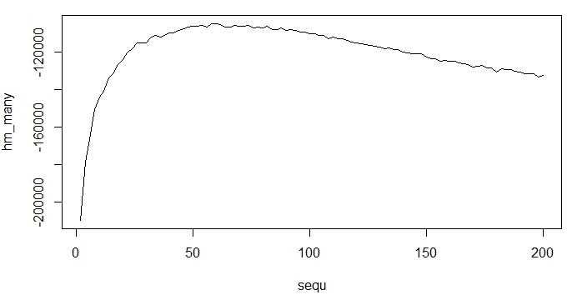
Deciding optimal no. of topics :
Plotted log likelihood corresponding to each of the topics.
LDA algorithm applied from 2 to 200 at steps of 2 and then estimating the best fit of the LDA outcome depending on the number of topics.
Optimum no. comes at 58
Chose 40 for LDA and 30 for CTM using sense and considering repetition
Notes:
K

Slide 13
Results of LDA :
Notes:
K

Slide 14
Topics Found ; CTM :
Notes:
A

Slide 15


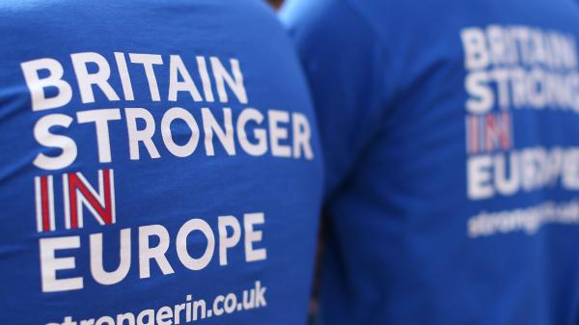

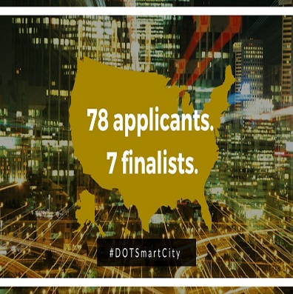

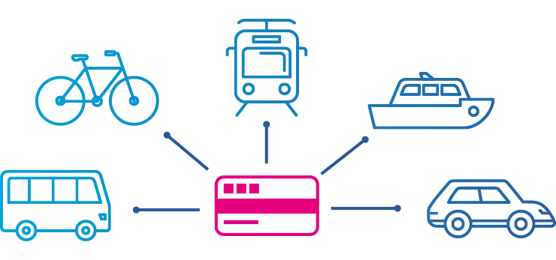

Brexit
London: Global connected city
Corporates against
IoT startup by CISCO
Energy management
Water management
Prevent waste
Million Dot Challenge
DoT, US
Columbus, Ohio
Smart transportation
Participation of Denver & Pittsburgh is Smart City Challenge
Top 7 finalists
Mendix
Acquisition of Netcore by Gaia smart cities
IoT
IoT enabled cars
Technotopia
Notes:
A

Slide 16

Gist of topics
Smart Cities
IoT
Smart travel
PPP
Million
Dot Challange
Smart network
Smart energy , grid, meter
Infrastructure
Big data & AI
Challenges
Start-ups
Eelctric Vehicle
Self Driven cars
Events ,summits
Cloud computing
Mendix
Connected Cars & humans
Smart water soln
Brexit
Investments Acquisitions
Notes:
K

Slide 17

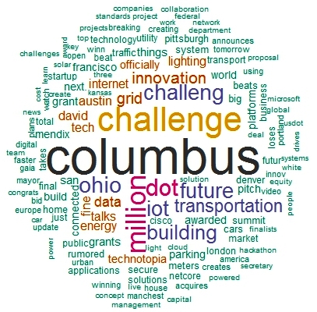
Word Cloud found :
Notes:
K

Slide 18
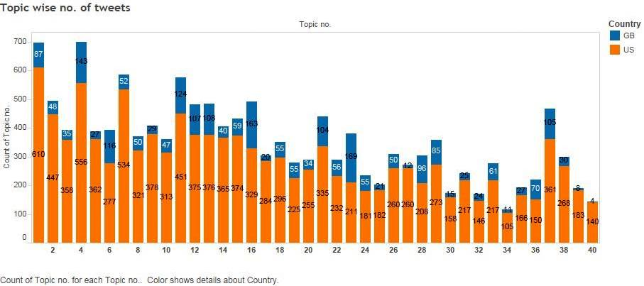
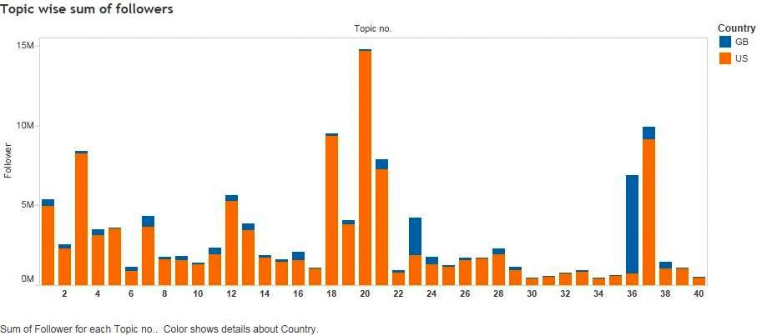

Geographic Distribution of topics across US & UK
Prepared data with topics , region and followers
Result is little biased because of the nature of data
US has more influence on discussions , which is evident
1st graph : Topics 1, 4, 7, 11, 12, 13, 16, 21, 37 are of utmost importance and have most number of tweets belonging to.
2nd graph : Topic 20 has the highest number of followers and the other important topics are 1, 3, 12, 18, 21, 36 and 37.
Notes:
K

Slide 19

Finding key influencers :
1. Read the file & initiate loop
2. Read unique tweets based on user id
3. Find same tweets of later time => increment counter by 1
4. Find retweets => increment counter by 1
5. Check counter value for a host
6. Set counter as =0 and repeat
Thoughts and views are liked by population.
Effect the feelings, actions of others.
Influencer score = No. of re-tweets + No. of tweets copied
Assumption: No two tweets of exactly the same content be tweeted at any time without copying the original tweet.
Notes:
A

Slide 20

Key Influencers :
Host | Profile Information | Score | Followers
http://twitter.com/daily_paper | Daily tiding updates | 569 | 1361
http://twitter.com/brianjoneill | CEO of HouseMaids | 518 | 5984
http://twitter.com/bradsterhill | Stays updated in technology and web | 517 | 106
http://twitter.com/lacomputertech | Computer repair and IT servicing | 508 | 2207
http://twitter.com/steverobinsojr | Gadgets and technology stock enthusiast | 501 | 1034
http://twitter.com/tweetfortechies | Interested in Smart cars, virtual machines | 500 | 356
http://twitter.com/techtweeties | Interested in technology websites | 494 | 332
http://twitter.com/techallo | Interested in technology news and updates | 492 | 279
http://twitter.com/webtech_update | Updates on latest news and opinion | 491 | 650
http://twitter.com/rosettemak | Techie, Digital marketer | 488 | 44
Notes:
A

Slide 21






LA Computer Tech :
Onsite computer repair and IT servicing
Tweets regarding minute tech details, cool computers, iPhone.
Brandon Hill
: Stays updated latest in tech and web.
Techallo
Technology news and updates
Not restricted to any specific technology
Brian o’ Neil :
Co-Founder and CEO of House Maids.
Residential cleaning services throughout Sarasota, Florida.
Master in Service Industry.
Daily Papers :
Tweets regarding daily tidings
Notes:
A
Image source:
http://twitter.com/daily_paper
http://twitter.com/brianjoneill

Slide 22





Web Tech Update
Latest news and opinion on everything.
Steve Robinson Jr
Tech enthusiast
Tech gadgets, Tech stocks.
Tweets for Techies
Tweets about latest technology
Smart cars, Virtual machines, E-Commerce
Mak Rosette
Techie, Digital Marketer
Interest areas: Internet security and Privacy, Startups
Tech Tweeties
Tweets from Technology websites
Notes:
A
Image source:
http://twitter.com/steverobinsojr
http://twitter.com/tweetfortechies

Slide 23

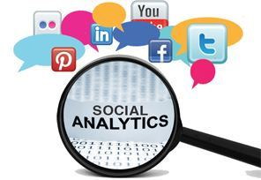

Business Economics and benefits
VOC
Targeted Marketing
Grievance Redress
Product & Service dev
Economic
Market Insights & research
Network study
Notes:
K

Slide 24


Conclusion and scopes of improvements
Cost effective solution
Topics in line with our business understanding
The change in classic framework of marketing : Knowing customer is a different ball game now
Identification of key influencers can help in branding & positioning
Targeted marketing approach
Future scope : Application of Hidden Markov Modelling (Ref.: . Gruber, Zivi, & Weiss, 2007) and Tensor Factorization (Ref. :Arora, 2015)
Notes:
K

Slide 25


